Slide 1
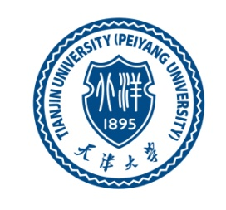

Wastewater treatment in Liberia
2020-11-11
Sewage Treatment – Final Presentation
Name of Presenter: Catherine B. Merchant (梅霖)
ID #: 6317000091

Slide 2
TABLE OF CONTENTS
1. Introduction
2. Overall situation of WWTPs
3. Different wastewater treatment processes in your own country
3.1. Application of different treatment processes
3.2. Pollutant removal efficiency of different processes
3.3. Sludge yield of different wastewater treatment processes
4. Existing problems
5. Conclusion
6. Recommendation
7. References

Slide 3
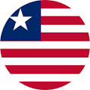
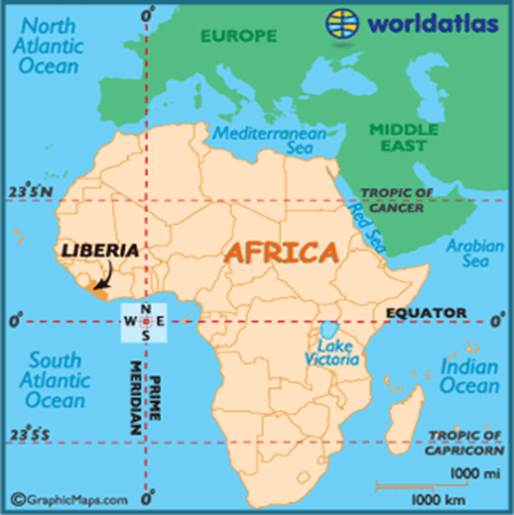
INTRODUCTION
ABOUT LIBERIA
Country: Liberia
Capital: Monrovia
Population: 4.814 million (2018)
Continent: Africa
Region: West Africa
Ocean: Atlantic Ocean
Land Area:43,000 mi²/111,369 square kilometers
Major resources: Timber, Iron ore, gold , diamond, and rubber

Slide 4
INTRODUCTION
In urban areas, the Liberia Water and Sewer Corporation (LWSC) is responsible for water and sanitation supply.
LWSC’s mandate is to provide safe water supply and sanitation services to the urban areas with a population above 5,000 inhabitants.
These currently include Monrovia, Buchanan, Kakata, Zwedru, Sanniquellie, Harper, Voinjama, Tubmanbourg, Greenville and Robertsport.
On-site facilities in the capital (e.g. septic tanks) are, however, managed privately or by the Monrovia City Council, and the actual extent of the off-site sewer network run by LWSC is very limited.
The Fiamah Treatment Plant and White Plain Treatment Plant are the only functional plants in Monrovia.

Slide 5
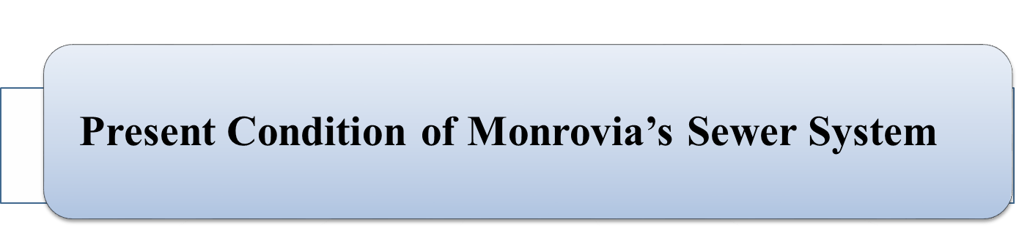
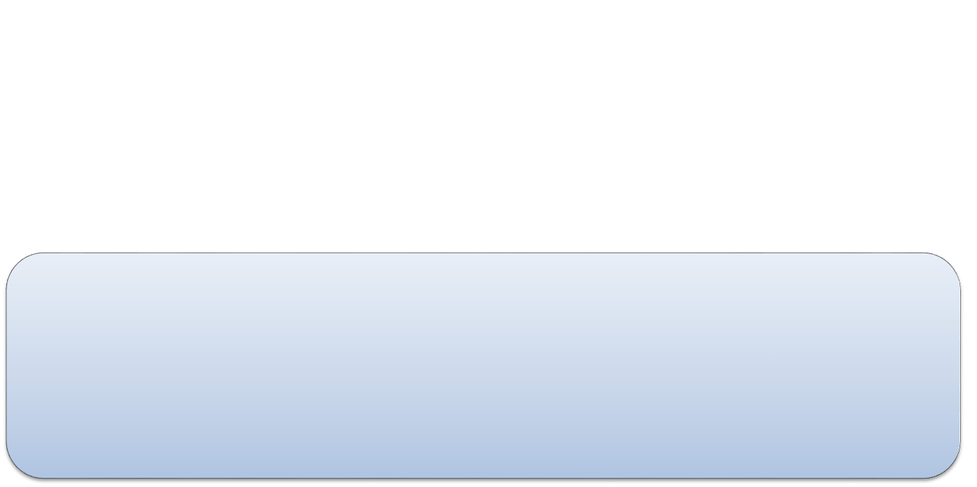

Application of different treatment processes
An off-site piped sewerage system was constructed in Monrovia in the 1950s and 1960s, covering an area of approximately 27 square kilometers in central Monrovia, Sinkor, Old Road and Bushrod Island (New Kru Town, Logan Town, Clara Town), less than 20% of the Greater Monrovia urban area.
In the original design, sewage from these areas was transmitted through a total of 64 kilometers of pipes to the Fiamah Sewage Treatment plant located in Sinkor, which had a capacity of 6 million gallons per day.

Slide 6
Application of different treatment processes
Table 2: Original location and length of sewage pipelines (Source: JICA)
Area | 8”-12” Diameter (meters) | 14”-20” Diameter (meters) | 24”-42” Diameter (meters) | >42” Diameter (meters) | Total (meters)
New Kru Town Pump Station to New Kru Town | 1,726 | 717 | - | - | 2,443
Bushrod Islands Pump Station to Logan Town and Clara Town | 5,916 | 1,455 | 4,310 | - | 11,680
Mesurado River Pump Station to Central Monrovia (Central Monrovia A and B) | 4,313 | 137 | 658 | - | 5,108
West Point | no sewer pipes
BTC Pump Station to Central Monrovia (Central Monrovia A and B) | 17,992 | 161 | 3,191 | 698 | 22,042
Fiamah Treatment Plant (incl. gravity pipes to Sinkor and Old Road areas) | 14,136 | 970 | 4,283 | 3,600 | 22,989
Congo Town, Paynesville and other areas | no sewer pipes
Total | 44,083 | 3,440 | 12,442 | 4,298 | 64,262

Slide 7
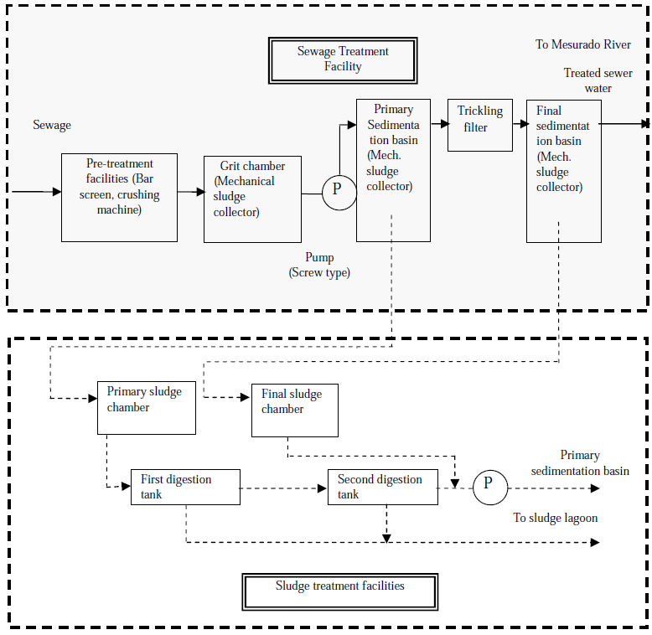
Application of different treatment processes
Figure 1: Design of Treatment Process at Fiamah Plant (Source: JICA)
.

Slide 8

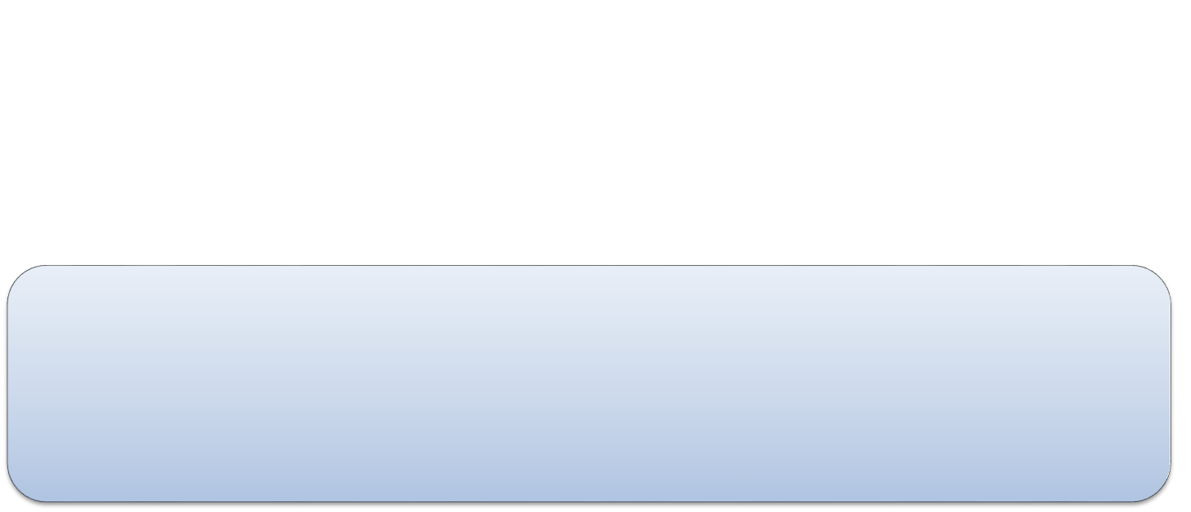

Application of different treatment processes
On July 29, 2015, the Liberia Water and Sewer Corporation (LWSC) and a Chinese construction company Chongqing International Construction Corporation (CICO) igned a $10.6 million contract for the rehabilitation of the White Plains Water Treatment Plant 21 km transmission line, which runs from White Plains to Red-Light in Paynesville in Monrovia, Liberian capital.
The contract which was awarded to Chongqing International Construction Corporation (CICO) was set to be a big boost to Liberia’s water industry as the plant which has been supplying water to the Northern parts of Liberia was out of age.
The agreement between the the government and Chongqing International Construction Corporation sought to construct and rehabilitate Liberia’s water treatment plant. It includes a 36 inch diameter pipline covering 21 kilometers from White Plains to Red-Light in Paynesville.

Slide 9
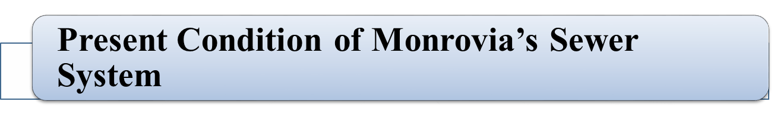
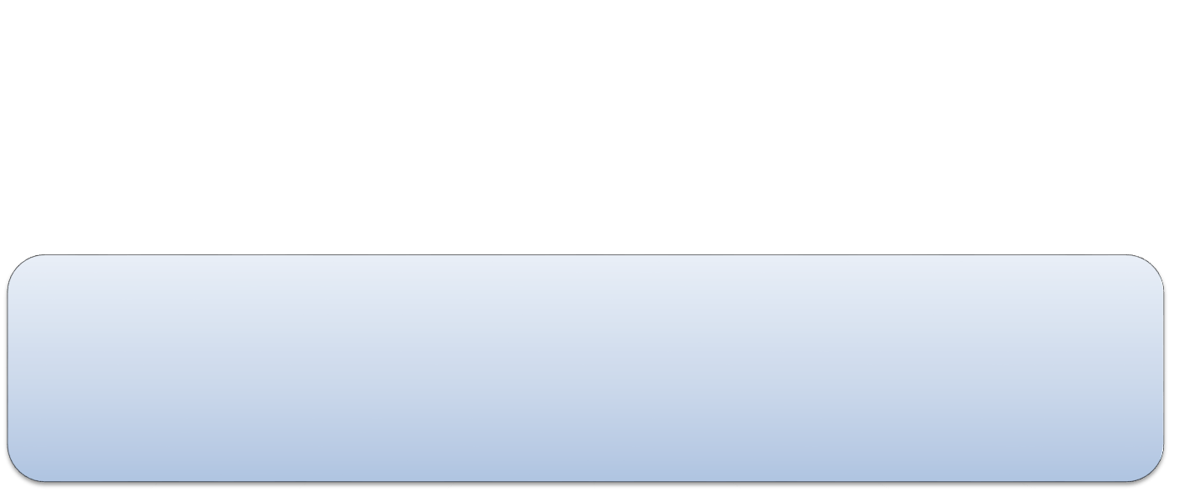

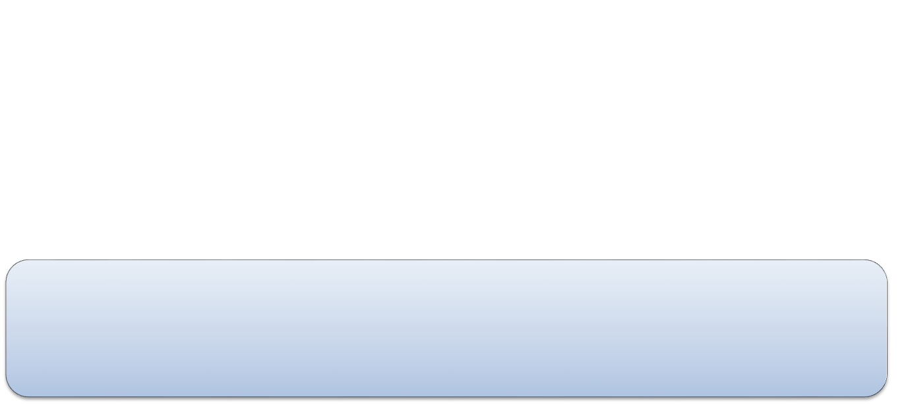
Application of different treatment processes
In Monrovia, the water supply service is mainly based on a surface water source from the nearby St. Paul’s river.
The raw water is pumped to the White Plains Treatment Plant (WTP) and treated water distributed to the population through a distribution system. Only small parts of Monrovia currently have direct access to the pipe water supply.
Prior to the civil unrest there were a number of sanitation facilities.

Slide 10
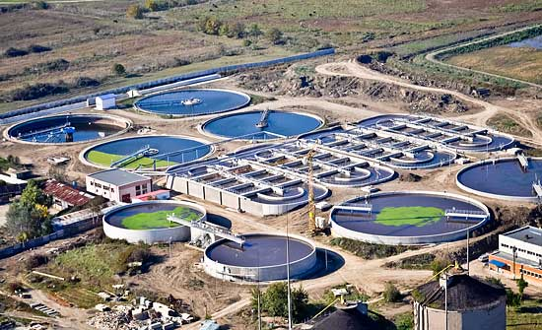
Application of different treatment processes
Fig 2: Liberia White Plain Water Treatment Plant

Slide 11
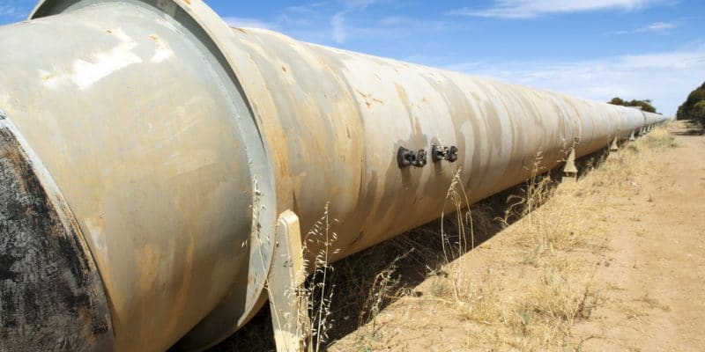
Application of different treatment processes
In Liberia, a 5 km pipeline now carries water pumped from the Mount Coffee Dam near the capital Monrovia to the White Plains water treatment plant in Louisiana’s Montserrado County. The Liberia Water and Sewer Corporation (LWSC), the state-owned company responsible for water management in Liberia, has just completed work to upgrade the 30-year-old facility. In November 2019, when work began, LWSC officials said that the old water pipe, built in 1990, was already showing signs of obsolescence. A condition that, according to the state-owned company, was “significantly” affecting the drinking water supply of nearly one million people living in Monrovia.

Slide 12
CHALLENGES
Challenges for water and wastewater treatment
Lack of access to safe, clean water
Access to water as a basic fundamental right of citizens has become a struggle for survival for most Liberians.
The lack of access to safe, clean water – especially mass shortages across the capital Monrovia and its surroundings, including the slum of West Point – during the continuing dry spell there remains a big challenge.
2. Insufficient infrastructure
Limited sewer collection is a bottleneck for wastewater treatment in Liberia.
3. Poor operation and maintenance
Poor operation and maintenance is a challenge for WWTPs and waterworks. For some manufacturers in Liberia, they cannot get applicable technologies to remove pollutants from their industrial wastewater due to limited available information and experiences. Some waterworks are facing challenges for the dosage of coagulants when the turbidity is too high or too low.

Slide 13
RECOMMENDATIONS
Based on the current practices and challenges, here I propose the following recommendations for the improvement of water and wastewater treatment in Liberia.
1. Transforming to green economy
It is imperative to move from the end‐of‐pipe water pollution control mode to more proactive pollution prevention. A green economy and cleaner production should be employed to reduce wastewater discharge and to recycle resources from wastewater. Green economy can also minimize the impact of human activities on the ecosystem, and the protection of ecosystem can conserve and preserve water quality.
2. Improving operation and maintenance
It is important to provide training and to enhance the expertise for the operation and maintenance of the facilities for water and wastewater treatment. Otherwise the facilities in waterworks and wastewater treatment plants cannot work effectively. Capacity building is needed to improve the knowledge of the workers in this sector. Only qualified and efficient operators and managers can ensure the smooth operation of these treatment facilities. In addition, those who construct the water and wastewater treatment facilities should establish necessary maintenance mechanisms so that these facilities can run sustainably.

Slide 14
RECOMMENDATION
3. Improving governance and management
The low priority accorded to water sector leads to poor water quality. The governments usually do not have political will to emphasize water and wastewater treatment because this is not considered as “vote winning”. It was suggested that local planning processes need to be reformed so that local politicians commit more strongly to improving water supply. To establish good governance with a better mechanism and institutional framework is a key to avoiding the lack of political will and commitment for water and wastewater treatment. The management of drinking water quality, wastewater discharge, and solid waste disposal should be enhanced. The regulatory authorities should put up legislations and rules to require industries to establish on‐site pre‐treatment facilities.
4. Harvesting energy
Energy is of vital importance for the water and wastewater treatment systems. However, Liberia lacks reliable energy supply systems. One possible solution is the utilization of solar energy. The other possibility is to recover energy from wastewater or waste sludge. For example, upflow anaerobic sludge blanket reactor makes it feasible to harvest biogas from wastewater, and a microbial fuel cell pit latrine is supposed to be used in Ghana to harvest electricity and to prevent groundwater pollution.

Slide 15
REFERENCES
G., B., & Foundation, M. G. (2009). Inclusive Municipal Governance in Monrovia- Annual Report
(OWAS), W. a. S. D. (2007). MONROVIA WATER SUPPLY AND SANITATION REHABILITATION PROGRAMME APPRAISAL REPORT-African Development Bank.
AWF. (2008). Study for the expansion of Monrovia water supply and sanitation system and rehabilitation of water supplies of 3 country capitals- Project apprisal report (African Water facility).
Fewtrell L, Prüss-Üstün A, Bos R, Gore F, Bartram, & WHO. (2007). Water, sanitation and hygiene: quantifying the health impact at national and local levels in countries with incomplete water supply and sanitation coverage.

Slide 16
Thank you
Your company slogan in here

